Slide 1

Creating (Maybe)
‘The World’s First’
Book Reference Website!!
Paul Dean, Soobin Hwang, Seunghwa Jun
UofTSTG201905DATA3 ｜ Oct 10, 2019

Slide 2
1 | Outline of the Project
2 | Reference List & Search
3 | Reference Dashboard
4 | Latest Articles

Slide 3
Outline
1
DD
DDD
[ dd ]
Ddd
[ dd ]
ddd

Slide 4
Outline
1
DD
DDD
[ dd ]
Ddd
[ dd ]
ddd

Slide 5
1 | Outline of the Project
2 | Reference List & Search
3 | Reference Dashboard
4 | Latest Articles

Slide 6
Outline
1
DD
DDD
[ dd ]
Ddd
[ dd ]
ddd

Slide 7
1 | Outline of the Project
2 | Reference List & Search
3 | Reference Dashboard
4 | Latest Articles

Slide 8
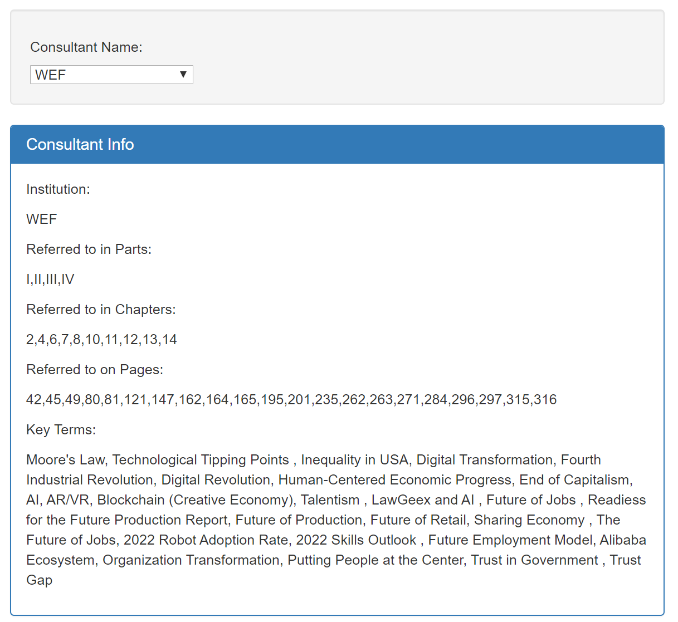
Reference Dashboard
1
Displaying detailed consultant info using dropdown menu

Slide 9
Reference Dashboard
5
Overview of Steps
Import data from JSON file into app.js using d3.json().then
Collect the consultant name selection using element.property(‘value’)
Filter the data using that consultant name,
and create lists of unique parts, chapters,
etc. using if(list.includes(item)) statements
Print data to the info box by
iterating through
those lists

Slide 10
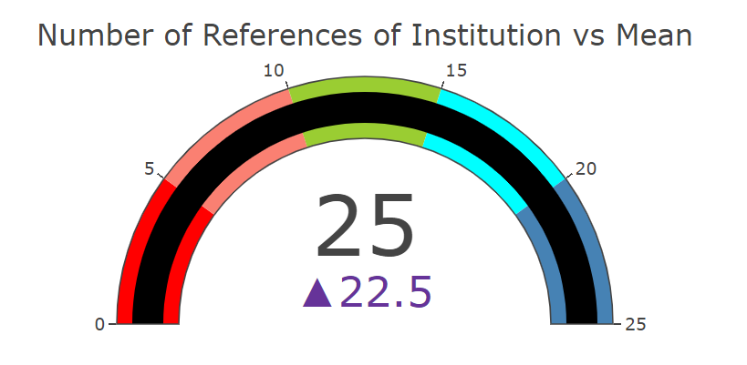
Reference Dashboard
1
Displaying gauge info using dropdown menu

Slide 11
Reference Dashboard
5
Overview of Steps
Import data from JSON file into app.js using d3.json().then
Collect the consultant name selection using element.property(‘value’)
Filter the data using that consultant name,
and collect the number of times that consultant name was referenced
Feed that reference count amount into plotly using mode:
mode: 'gauge+number +delta'

Slide 12
1 | Outline of the Project
2 | Reference List & Search
3 | Reference Dashboard
4 | Latest Articles

Slide 13
Outline
1
DD
DDD
[ dd ]
Ddd
[ dd ]
ddd

Slide 14
Outline
1
DD
DDD
[ dd ]
Ddd
[ dd ]
ddd

Slide 16
1 | 템플릿 구성
2 | 템플릿 기본 가이드
3 | 활용소스 – CI, 슬로건
4 | 활용소스 – 아이콘
5 | 활용소스 – 다이어그램, 지도
6 | Q&A

Slide 17

활용 소스
5
다이어그램
Linear A
TEXT
TEXT
TEXT
TEXT

Slide 18
활용 소스
5
다이어그램
Linear A
TEXT
TEXT
TEXT
TEXT

Slide 19
활용 소스
5
다이어그램
Flow 4
텍스트
텍스트
텍스트
텍스트
텍스트
텍스트
텍스트
텍스트
텍스트
텍스트
텍스트
텍스트
텍스트
텍스트
텍스트
텍스트

